Slide 1

Configuring programs and using APIs
Data Sciences Institute
University of Toronto
Simeon Wong
Notes:
Hi everyone, welcome back to our 3rd week of Data Science Fundamentals

Slide 2

Meet your instructor
Introductions
Simeon Wong
4th year PhD @ Institute of Biomedical Engineering
Research Analyst @ Hospital for Sick Children
I read minds! (of children with epilepsy using implanted electrodes)
MRI, CT image processing
EEG, MEG signals processing
Neuromodulation platforms for research

Slide 3
Meet your TA
Introductions
Tong Su
4th year undergrad @ University of Toronto
Computer Science Specialist and Statistics Major
Full-stack developer at Northbridge (Co-op)
Research Interest: Computer Vision, Natural Language Processing, and Machine Learning

Slide 4
Asking questions
Zoom chat during class
Feel free to post and answer questions at any time
I will pause for questions occasionally, and review questions from the chat
Pre- / Post-class office hours with Tong
Email
simeonm.wong@mail.utoronto.ca
tong.su@mail.utoronto.ca

Slide 5
Daily scrum
Write in the chat:
How you’ll use one thing you’ve learned so far
One thing you’re struggling with / wish the course addressed
What you’re looking forward to in this course

Slide 6
Course overview
Configuration files & Environment variables
Using and writing Application Programming Interfaces (APIs)
Handling errors
Testing software
Building Python packages
Working in software teams using GitHub features

Slide 7
Course overview
Configuration files & Environment variables
Using and writing Application Programming Interfaces (APIs)
Handling errors
Testing software
Building Python packages
Working in software teams using GitHub features

Slide 8
Assessments
Outcomes-based learning
> 75% of course outcomes
Assessed with both in-class exercises and summative project
Summative project:
The next 4 classes build on each other
We will work on the summative project step-by-step through each class

Slide 9
Today’s learning outcomes
I can interpret and write simple YAML files
I can load YAML files into Python
I can read command line arguments from Python
Given documentation, I can use a Python or HTTP API

Slide 10
Why configure?
Configuring programs
Programs are only useful if they can be controlled.
Work inside programs is reproducible only if controls are explicit (documented and understandable) and shareable.
Programs may need to work differently in different contexts:
Operating systems
Data directories
Localization: language, region settings
Analytical methods or outputs (e.g. linear vs quadratic regression)

Slide 11
Data sources
Configuring programs
Data that controls how a program functions can come from multiple sources:
Context
Current operating system
System language
Files
Configuration files or job description files
Dynamic sources
Network server, Secrets manager, Azure/AWS/GCP configuration server, etc…

Slide 12
Layers of configurations
Configuring programs
Default program configuration
System-wide configuration
General settings that impact all users (and multiple programs)
User-specific configuration
Personal preferences
Job-specific configuration
Run-specific information
Command-line options
Frequently changed, or on-the-fly configuration

Slide 13
Default program configuration
Configuring programs → Layers of configurations
Sensible defaults included with the program
Designed to be generally useful for most people who run the program
e.g. matplotlib default colour is blue
Consider different types of users
Be careful of unexpected behaviour if left unconfigured
e.g. Program that saves data to financials.xlsx by default
Might unintentionally overwrite users’ files
Some defaults should not be set to force users to specify

Slide 14
System-wide configuration file
Configuring programs → Layers of configurations
Purpose: To provide default settings applicable to all users of a system.
Impact: Changes affect every user and application on the system.
Modification and Risks: Editing system-wide files requires caution as incorrect settings can impact system stability.
e.g: Modifying a system-wide configuration file in an operating system to change the default network timeout settings. This change will affect all network-related operations for all users, even those using other programs.

Slide 15
User-Specific Configuration
Configuring programs → Layers of configurations
Scope: Settings that apply only to a single user's environment.
Flexibility: Allows personalization without affecting other users.
Storage: Typically stored in user's home directory or specified user profile sections.
e.g: A user creates a configuration file in their document editor to set a default font size and page layout, different from the system-wide defaults.

Slide 16
Job-Specific Configuration
Configuring programs → Layers of configurations
Application: Used for settings that apply to a specific task or project.
Priority: Overrides system and user-specific settings for the job's duration.
Creation and Use: Crafted for individual projects or tasks, often located within the project directory.
e.g: Setting up a configuration file in a data analysis project to specify data sources and output formats unique to that project.

Slide 17
Command-line options
Configuring programs → Layers of configurations
Use: For temporary adjustments or one-off changes.
Flexibility: Allows quick, on-the-fly changes without altering permanent configurations.
Best Practices: Use for frequent or minor changes; avoid for complex configurations.
e.g: Running a file compression tool with command-line options to set a high compression level for a specific large file, overriding the default compression setting.

Slide 18
Layers of configurations
Configuring programs
Default program configuration
System-wide configuration
General settings that impact all users (and multiple programs)
User-specific configuration
Personal preferences
Job-specific configuration
Run-specific information
Command-line options
Frequently changed, or on-the-fly configuration

Slide 19
Overlay/override system
Configuring programs
The same option is valid in multiple configuration layers
Options read from more specific layers override settings configured in more general ones
e.g: Plot colours for an analysis program
Program’s default colour is blue (matplotlib default)
Your organization’s brand colour is green (system-wide)
For this specific analysis, need to use orange (job-specific)

Slide 20
What questions do we have?

Slide 21
Demo: Google Colab Terminal
Course logistics
UofT DSI uses Google Colab for Python
Parts of this course will require using Git and Python from the command line (instead of the notebook interface)
If you have a Unix shell, Git, and Python installed locally: feel free to use that
If you are not sure or you do not: we can access a basic shell on Google Colab

Slide 22
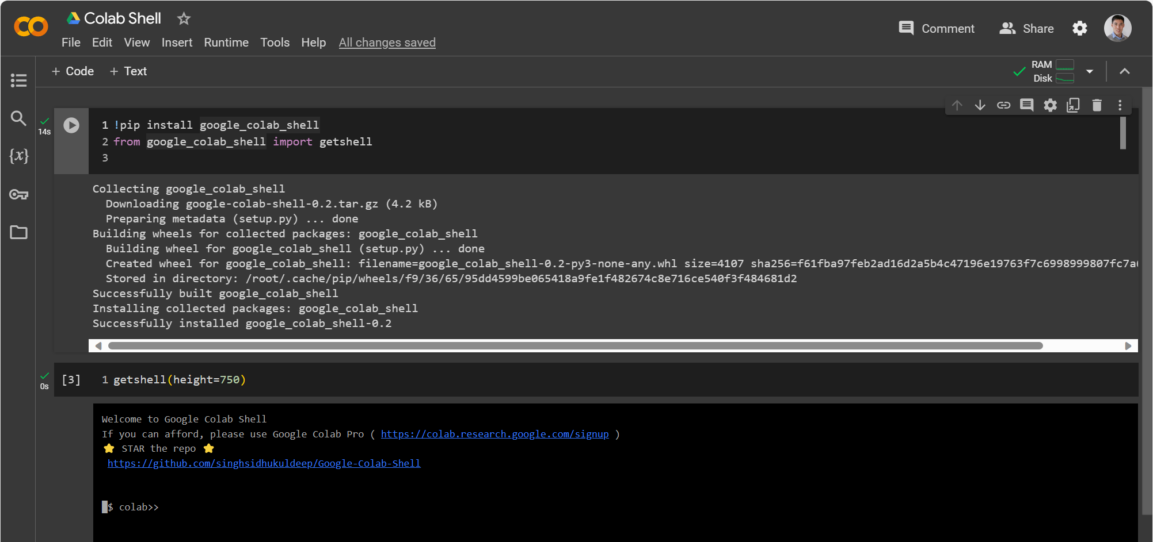
Demo: Google Colab Terminal
Course logistics

Slide 23
Command-line arguments in Python
Configuring programs
The argparse library built into Python is used to interpret command-line arguments
Common types of command-line arguments
Positional argument (e.g. mv oldpath newpath)
Flags (true/false values) (e.g. ls –l)
Options with values (e.g. head –n 5)

Slide 24
$> Interactive live coding
Configuring programs
Create a Python script in Google Colab (or on your local computer)
Make it print “Hello World!”
Referring to the argparse documentation:
Initialize argparse
Write a short description
Add a positional argument for greeting target
Add an option for number of repeats
Add a flag for saying goodbye

Slide 25
What questions do we have?

Slide 26
Configuration file formats
Configuring programs
Popular Formats:
INI – older format for simple, structured data
Commonly found in compiled Windows / Linux programs
JSON – older standard, flexible, can be difficult to type by hand
YAML – new standard, readable and flexible
Due to its flexibility and readability, especially for complex configurations, YAML is recommended.

Slide 27
The YAML format
Configuring programs
key: value
dict:
key1: value1
key2: value2
list:
- value1
- value2
# comment
“YAML is Another Markup Language”
Online tools for browsing YAML:
https://codebeautify.org/yaml-parser-online
Notes:
pi: 3.14156
new_year: true
data_path: "/home/simeon/analysis1"
dsi_topics:
- python
- github
- research software
plot_colors:
line: blue
axis: black

Slide 28
$> Interactive live coding
Configuring programs
Create a YAML file in Google Colab
Write Python code to load and consolidate YAML files
Exercise: Write your own configuration files
For an analysis where a dataset is loaded and two columns from the dataset are plotted on the x and y axes in your favourite colour
Variables: dataset_url (str), cols_to_plot (dict with x and y str), color (str)
Which configuration levels do these variables go into?

Slide 29
What questions do we have?

Slide 30
Today’s overview
Lesson overview
Configuration files & Environment variables
Using and writing Application Programming Interfaces (APIs)

Slide 31
What is an API?
Application Programming Interfaces
API stands for Application Programming Interface
Allows software programs to communicate with each other
Provides structured way to communicate between applications and devices (expose data and functionality)
Allows other developers to access and integrate with an application without needing to understand complex implementation details

Slide 32
Programs using programs
Application Programming Interfaces
You’ve already used APIs!
Python APIs: matplotlib, numpy, pandas
Web APIs: City of Toronto open data API

Slide 33
Public APIs vs Private APIs
Application Programming Interfaces
Public vs private refers to access, visibility, and documentation
Public APIs
Available openly for any developer to use
Well-documented and robustly coded to account for different (and untrusted) requests and input from the public
Public Web APIs: Just need to sign up and get an API key to access
e.g. GitHub, Spotify, YouTube

Slide 34
Public APIs vs Private APIs
Application Programming Interfaces
Private APIs
Access is restricted to internal apps or trusted external partners and requires authorization
May be coded/documented for very specific use cases
For interacting with internal data and functionality safely
e.g.: APIs for internal tooling, bank partnerships

Slide 35
Public APIs vs Private APIs
Application Programming Interfaces
When writing APIs for public use:
Must validate inputs strictly
Defend against coding mistakes
Defend against malicious users (e.g. access to unauthorized data, system compromise)
Must document extensively
Tradeoff between additional utility and engineering-hours

Slide 36
What questions do we have?

Slide 37
The RESTful Web API
Application Programming Interfaces
The RESTful Web APIs are a quasi-standard method of performing actions using or exchanging data with web-connected services
e.g. Retrieve list of repositories from GitHub
e.g. Using GPT-4 to process datasets automatically
e.g. Starting and stopping a container hosted on Microsoft Azure
REST: “Representational State Transfer”
Uses HTTP requests: GET, POST, (PUT), (DELETE)
Generally, returns data in machine-readable formats like JSON

Slide 38
The RESTful Web API
Application Programming Interfaces
Uniform interface
Every entity (piece of data) is generally retrieved from the same URI
Client-server decoupling
The web interface is assumed to be the only link between the client and the server
Data isn’t getting passed through a separate channel (e.g. file on hard drive)
Statelessness
All required information is included in the request
Identity is established on every request (usually via a secret token)

Slide 39
The RESTful Web API
Application Programming Interfaces
Client
GitHub API
(https://api.github.com)
GET /user
Authorization Bearer zn4 … 2l3
“Get details about myself.
I am identified by … “
{ "login": "octocat", "id": 1, "node_id": "MDQ6VXNlcjE=", "avatar_url": "https://github.com/images/error/octocat_happy.gif", "gravatar_id": "", "url": "https://api.github.com/users/octocat", "html_url": "https://github.com/octocat", … }
“Here are your details…
.. beeepboop …”

Slide 40
The RESTful Web API
Application Programming Interfaces
Client
GitHub API
(https://api.github.com)
DELETE /repos/owner/thisrepo
Authorization Bearer zn4 … 2l3
“Delete this repository!
I am identified by … “
Status: 204
“Done!” 💥
Notes:
Notice, there’s no confirmation. Generally, confirmation dialogs belong on the user interface side, not for program to program interactions with APIs.

Slide 41
API keys
Application Programming Interfaces
Unique string that acts like a password obtained by registering as a developer
Usually time-limited (hours to months)
Identifies the client: Usage tracking and access limits
API keys are usually sent in the request header
e.g. Authorization: Bearer 23748237842823442
Keep your key secret - don't share or expose!
Store using secrets manager or protected configuration file (.gitignore is your friend!)

Slide 42
Web API responses
Application Programming Interfaces
Consists of an HTTP response code + body
Response codes:
2xx = success (e.g. 200)
4xx = error with the request (e.g. 404 URI not found, 400 bad request)
5xx = error with the server (e.g. 500 internal server error)
The body is generally in JSON format (rarely, but sometimes in XML)

Slide 43
What questions do we have?

Slide 44
Making Web API requests in Python
Application Programming Interfaces
Use the requests library to communicate with the API
Use the json library to parse JSON responses
Sometimes companies release Python libraries that make it easier to use their APIs from Python
Simplify authentication, request validation, response parsing, etc…

Slide 45
$> Interactive live coding
Application Programming Interfaces
Generate a GitHub Personal Access Token (API key)
Settings > Developer Settings > Personal access tokens
Add token to Colab secrets manager
Refer to GitHub API Documentation
Use requests to retrieve own user details from GitHub Web API
This is a type of configuration!

Slide 46
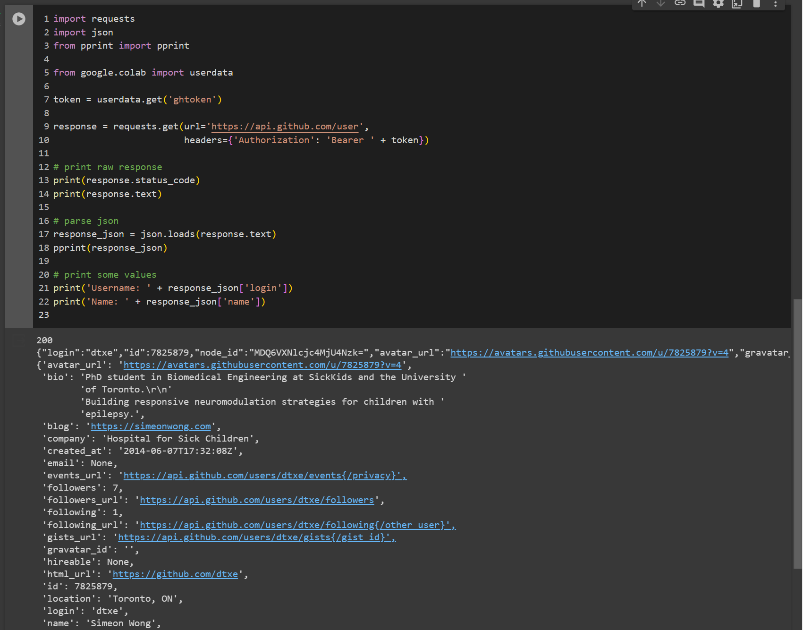
$> Interactive live coding
Application Programming Interfaces

Slide 47
What questions do we have?

Slide 48
Exercise: Explore the GitHub API
Application Programming Interfaces
Using the GitHub API documentation:
choose an interesting endpoint that returns data
write a Python request to retrieve data from that endpoint
bonus: visualize or analyze it in some way
Ideas:
List the top 20 most starred repositories using /search/repositories
List the top 20 most followed users using /search/users
Hint: try using q=stars:>1 or q=followers:>1

Slide 49
What questions do we have?

Slide 50
Today’s learning outcomes
I can interpret and write simple YAML files
I can load YAML files into Python
I can read command line arguments from Python
Given documentation, I can use a Python or HTTP API

Slide 51
Homework
Create a personal GitHub repository for today’s work
We suggest making it public
Otherwise, private with dtxe and sue-tong as collaborators
Commit your Hello World and your GitHub API code
Write a suitable commit message
Write a simple README.md file
Push your commit and submit your work here: https://uoft.me/dsi-1-bs-a1

Slide 52
References
Research Software Engineering with Python by Damien Irving, Kate Hertweck, Luke Johnston, Joel Ostblom, Charlotte Wickham, and Greg Wilson (https://merely-useful.tech/py-rse/config.html)

